Slide 1
SUPER MARIO BROS. GENETIC AI
Joshua Bacon-Qaunaq
#3720274

Slide 2
Original Plan
Learn the program.
Look at the algorithms in place for Reinforcement Learning.
Decide on how to change the algorithms.
Implement the changes sequentially so errors and mistakes can be found and changed while working on the project.
Compare my findings to the original findings.

Slide 3
“State-of-the-Art-Research”
Because my project is based off of a program that has already been created, the “State-of-the-Art-Research” is the base program itself.
This program will use fitness values to determine the best individual in a group and increase their chance to reproduce.
The original creator also implemented a lot of functions that are difficult compared to what we learned, whether they are better or more efficient depends on the results.

Slide 4
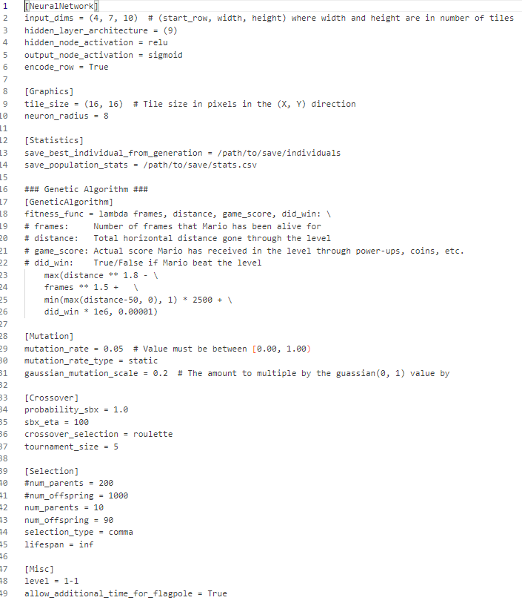
Configurations
Neural Network (observable environment, amount of nodes, math functions)
Statistics (just where the stats will go, always the same stats being recorded)
Genetic Algorithm (Uses lambda, but can be changed if adjusted in all files)
Mutation (how often, what kind, scale)
Selection (amount of parents, amount of children, best individual, lifespan)
Configuration

Slide 5
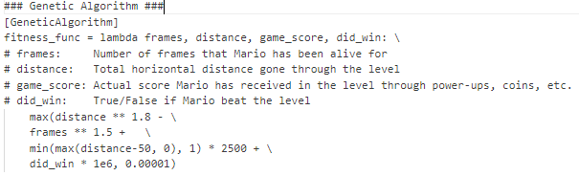
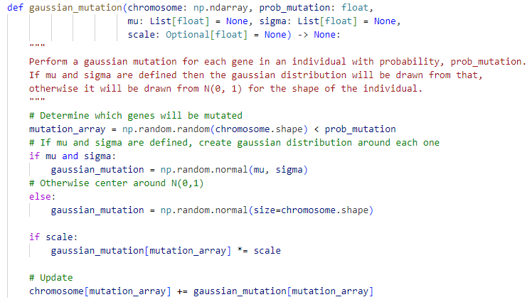
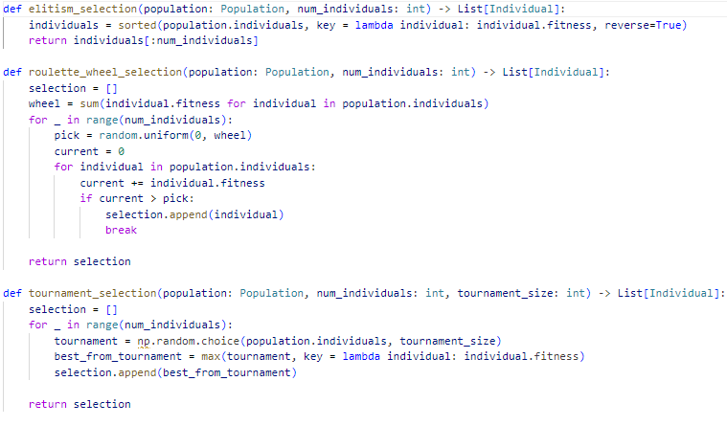
“Heuristics” - Reinforcement Learning
Fitness
Mutations
Selection

Slide 6
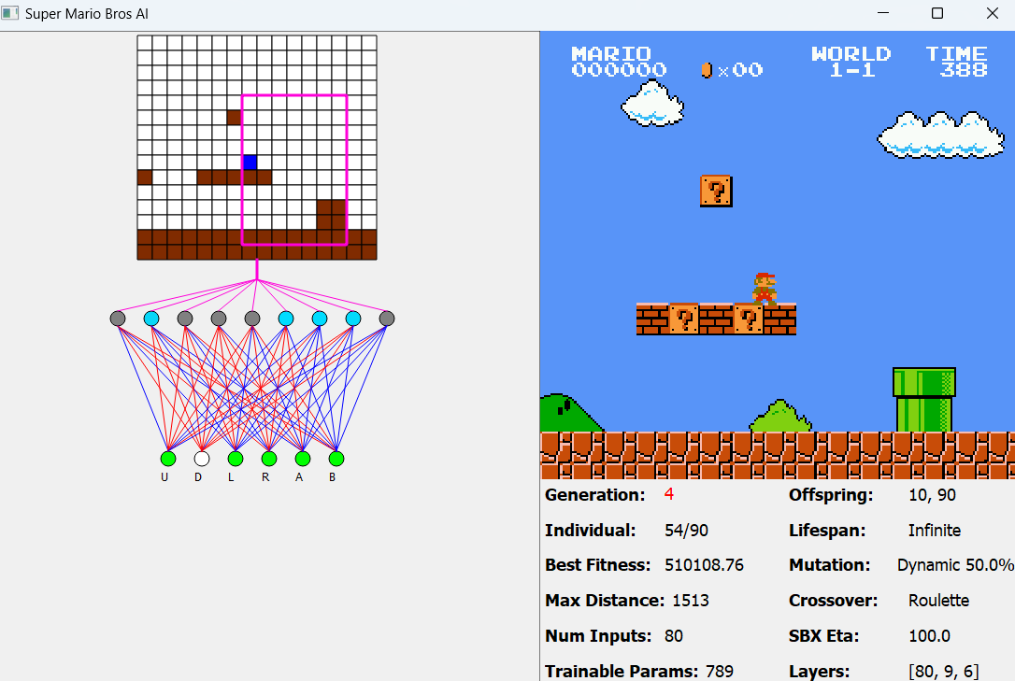
Findings
Can use original configs to change settings of the AI to create a better scoring system than the original. (Fine tuning)
The model struggles when applied to other worlds after being trained on a first one. (Most interesting)
Selection algorithm can implement a max heap which is more efficient than the original creator’s sorted function. (Fine tuning)
Changing the type of AI would basically require a whole new program to be built. (Failure)
Changing the style of scoring, fitness and selection are also difficult, and ultimately failed. (Difficulty)
AI Training

Slide 7
Failures and Successes
Changing the AI type failed massively, there is no viable reason to change it from Reinforcement Learning to supervised or unsupervised. (Failure)
After that failed, I narrowed my view to try and fine tune the tool. While this still failed, it is more feasible than changing the AI, and it can provide the results that I am looking for. (Failure)
I have been able to change variables in the AI in a way that can theoretically work as good or better than the original. But redundant scoring can actually hurt the algorithm such as game score from blocks or enemies. (Success ?)

Slide 8
Future Improvements
With more time, changing the functions of the AI would be easier since it would allow more leeway to do trial-and-error on any changes to implement difficult functions.
Getting a better understanding of how Reinforcement Learning works- this would allow me to understand and then modify the agent as needed to create a more efficient AI.
Organization, while the code and ideas were already organized beforehand by the original creator, I could have used their understanding to help me create an organized plan of action to go about this project.

Slide 9
THANKS YOU!
Any Questions?
Github: https://github.com/JBaconQa/CS-4795_Project

Slide 10
Bibliography
https://github.com/Chrispresso/SuperMarioBros-AI/blob/master/README.md
https://spj.science.org/doi/10.34133/icomputing.0025
https://arxiv.org/abs/2106.15877

